Slide 1


Slide 2

Monetary and financial policy since the financial train wreck of 2007-08
David Miles
Monetary Policy Committee
Bank of England
January 2014
Notes:
2

Slide 3
Bank Rate Since 1694
Source: Bank of England
Notes:
3

Slide 4
Level of Output Relative to Pre-Crisis Trend During Past Recessions ^{(a)}
I use a Hodrick-Prescott filter to separate the trend and the cyclical components of real GDP growth. I assume that trend growth at the start of each recession would have prevailed during the following seven years had the recession not occurred. The chart shows deviations of actual GDP from this projected trend growth. Last data point is 2013Q2. The dotted line for the latest recession uses the MPC’s mean projection for output growth over the forecast horizon as reported in the November 2013 Inflation Report. Data and trend growth estimates for the 1929 recession are taken from Hills, Thomas and Dimsdale ( Bank of England Quarterly Bulletin 2010).
Notes:
4

Slide 5
Annual Inflation
Source: ONS.
Last data: December 2013
Notes:
5

Slide 6
Commodity Price Indices (Jan 2007 = 100)
Note: Indices based on USD prices. The total commodities series uses the S&P GSCI index. Last data: 22 May 2013.
Sources: Standard & Poor's and Thomson Reuters Datastream
Notes:
6

Slide 7
Interest Rates Faced by Households and Firms
Note:
- The corporate borrowing rate is yield to maturity on bonds issued by companies with a current maturity of 1-10 years.
- The household unsecured borrowing rate is and average of credit card, personal loan and overdraft rates.
The household lending and deposit rate series show data on quoted rates by UK Monetary and Financial Institutions.
Data up to end-November 2013.
Source: Bank of England and Bank of America Merrill Lynch
Notes:
7

Slide 8
Bank of England’s balance sheet: Assets
Source: Bank of England.
Gilts are held via the Asset Purchase facility; see http://www.bankofengland.co.uk/markets/Pages/apf/balancesheetimpact.aspx for details.
Notes:
8

Slide 9
Bank of England’s balance sheet: Liabilities
Source: Bank of England.
Notes:
9

Slide 10
Sterling corporate bond spreads for financials, non-financials and high yield
Note: Option-adjusted spread over government rates. Merrill Lynch altered the methodology for estimating corporate bond yields on 17th December 2012,
causing a break in the series. Due to monthly index rebalancing by Merrill Lynch, movements in yields and spreads at the end of each month might reflect changes
in the population of securities composing the indices.
Sources: Bank of America/Merrill Lynch and Bloomberg.
Notes:
10

Slide 11
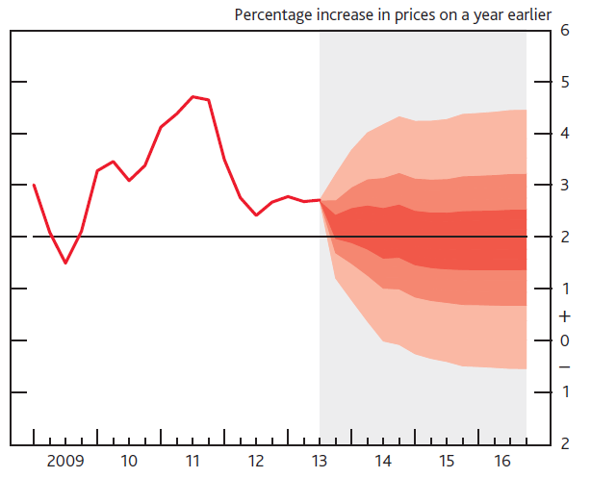
CPI inflation projection based on market interest rate expectations and £375 billion asset purchases
Source: Inflation Report, November 2013
This chart depicts the probability of various outcomes for CPI inflation in the future. They have been conditioned on the assumption that the stock of purchased assets financed by the issuance of central bank reserves remains at £375 billion throughout the forecast period. If economic circumstances identical to today’s were to prevail on 100 occasions, the MPC’s best collective judgement is that inflation in any particular quarter would lie within the darkest central band on only 30 of those occasions. The fan charts are constructed so that outturns of inflation are also expected to lie within each pair of the lighter red areas on 30 occasions. In any particular quarter of the forecast period, inflation is therefore expected to lie somewhere within the fans on 90 out of 100 occasions. And on the remaining 10 out of 100 occasions inflation can fall anywhere outside the red area of the fan chart. Over the forecast period, this has been depicted by the light grey background. See the box on pages 48–49 of the May 2002 Inflation Report for a fuller description of the fan chart and what it represents..

Slide 12
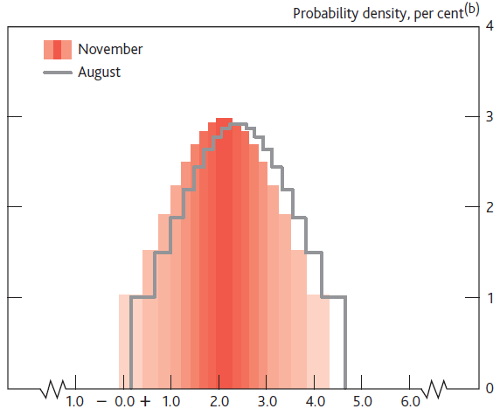
Projected cumulative probabilities of four-quarter
CPI inflation in 2015 Q2^{(a)}
Source: Inflation Report, November 2013
(a) This chart represents the cross-section of the CPI inflation fan chart in 2014 Q4 for the market interest rate projection. It has been conditioned on the assumption that the stock of purchased assets financed by the issuance of central bank reserves remains at £375 billion throughout the forecast period. The coloured bands have a similar interpretation to those on the fan charts. If economic circumstances identical to today’s were to prevail on 100 occasions, the MPC’s best collective judgement is that inflation in 2014 Q4 would lie somewhere within the range covered by the
histogram on 90 occasions. Inflation would lie outside the range covered by the histogram on 10 out of 100 occasions. The grey outline represents the corresponding cross-section of the August 2013 Inflation Report fan chart, which was conditioned on constant interest rates and the same assumption about the stock of purchased assets.
(b) Average probability within each band; the figures on the y-axis indicate the probability of inflation being within ±0.05 percentage points of any given inflation rate, specified to one decimal place. As the heights of identically coloured bars on either side of the central projection are the same, the ratio of the probability contained in the bars below the central projection, to the probability in the bars above it, is given by the ratio of the width of those bars.

Slide 13
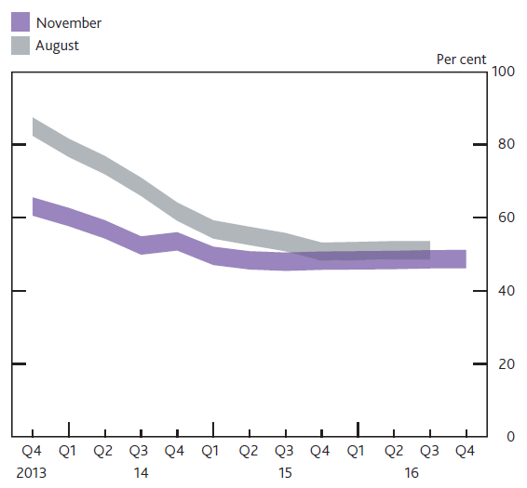
An indicator of the probability that inflation will be
above the target
Source: Inflation Report, November 2013
The November and August swathes in this chart are derived from the same distributions as the charts on the previous two slides. They indicate the assessed probability of inflation being above target in each quarter of the forecast period. The 5 percentage points width of the swathes reflects the fact that there is uncertainty about the precise probability in any given quarter, but they should not be interpreted as confidence intervals.

Slide 14
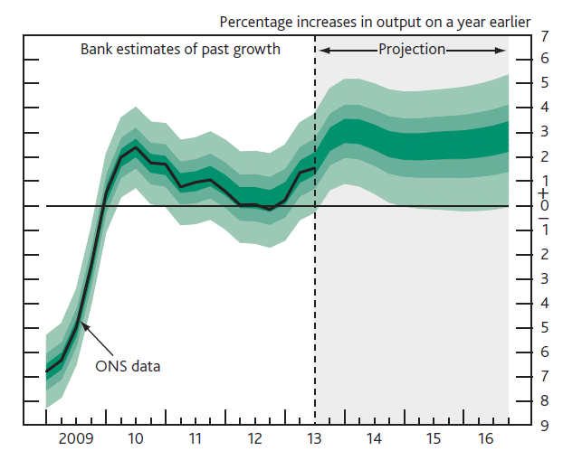
GDP projection based on market interest rate expectations and £375 billion asset purchases
Source: Inflation Report, November 2013
The fan chart depicts the probability of various outcomes for GDP growth. It has been conditioned on the assumption that the stock of purchased assets financed by the issuance of central bank reserves remains at £375 billion throughout the forecast period. To the left of the vertical dashed line, the distribution reflects the likelihood of revisions to the data over the past; to the right, it reflects uncertainty over the evolution of GDP growth in the future. If economic circumstances identical to today’s were to prevail on 100 occasions, the MPC’s best collective judgement is that the mature estimate of GDP growth would lie within the darkest central band on only 30 of those occasions. The fan chart is constructed so that outturns are also expected to lie within each pair of the lighter green areas on 30 occasions. In any particular quarter of the forecast period, GDP growth is therefore expected to lie somewhere within the fan on 90 out of 100 occasions. And on the remaining 10 out of 100 occasions GDP growth can fall anywhere outside the green area of the fan chart. Over the forecast period, this has been depicted by the light grey background. See the box on page 39 of the November 2007 Inflation Report for a fuller description of the fan chart and what it represents.

Slide 15
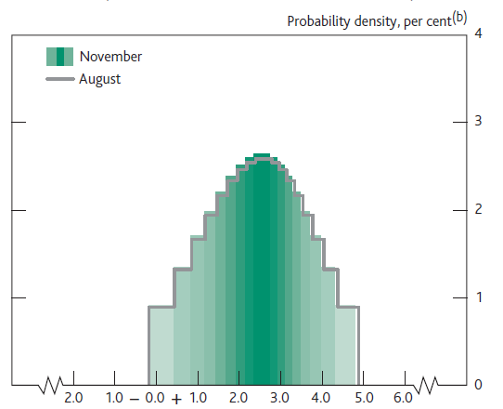
Projected probabilities of GDP growth in
2015 Q4 (central 90% of the distribution)^{(a)}
Source: Inflation Report, November 2013
(a) This chart represents the cross-section of the GDP growth fan chart in 2015 Q4 for the market interest rate projection. It has been conditioned on the assumption that the stock of purchased assets financed by the issuance of central bank reserves remains at £375 billion throughout the forecast period. The coloured bands have a similar interpretation to those on the fan charts. If economic circumstances identical to today’s were to prevail on 100 occasions, the MPC’s best collective judgement is that GDP
growth in 2015 Q4 would lie somewhere within the range covered by the histogram on 90 occasions. GDP growth would lie outside the range covered by the histogram on 10 out of 100 occasions. The grey outline represents the corresponding cross-section of the August 2013 Inflation Report fan chart, which was conditioned on constant interest rates and the same assumption about the stock of purchased assets financed by the issuance of central bank reserves.
(b) Average probability within each band; the figures on the y-axis indicate the probability of growth being within ±0.05 percentage points of any given growth rate, specified to one decimal place. As the heights of identically coloured bars on either side of the central projection are the same, the ratio of the probability contained in the bars below the central projection, to the probability in the bars above it, is given by the ratio of the width of those bars.

Slide 16
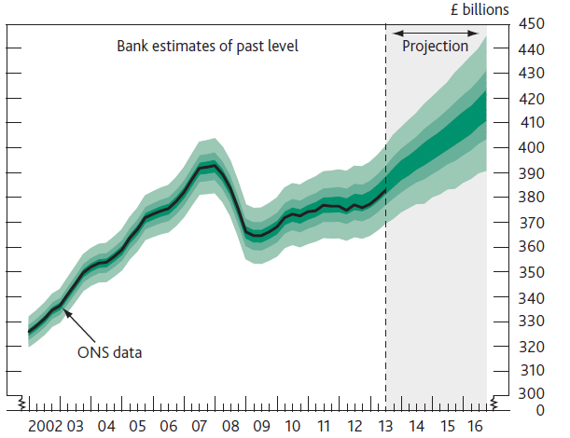
Projection of the level of GDP based on market interest rate expectations and £375 billion asset purchases
Source: Inflation Report, November 2013
Chained-volume measure (reference year 2010). See the footnote to Chart 5.1 in the November Inflation Report for details of the assumptions underlying the projection for GDP growth. The width of this fan over the past has been calibrated to be consistent with the four-quarter growth fan chart, under the assumption that revisions to quarterly growth are independent of the revisions to previous quarters. Over the forecast, the mean and modal paths for the level of GDP are consistent with Chart 5.1 5.1 in the November Inflation Report. So the skews for the level fan chart have been constructed from the skews in the four-quarter growth fan chart at the one, two and three-year horizons. This calibration also takes account of the likely path dependency of the economy, where, for example, it is judged that shocks to GDP growth in one quarter will continue to have some effect on GDP growth in successive quarters. This assumption of path dependency serves to widen the fan chart.

Slide 17
UK Debt by sector (% of GDP)
Source: ONS
The chart shows each sector’s total financial liabilities relative to GDP at market prices. Last data point is 2012.
Notes:
17

Slide 18
Monetary and Financial Institutions and OFC debt (% of GDP)
Source: ONS
The chart shows MFIs’ total financial liabilities relative to GDP at market prices. Last data point is 2012.
Notes:
18

Slide 19
UK Banks Leverage Ratio ^{(a)}
(a) UK data on leverage use total assets over equity and reserves on a time-varying sample of banks, representing the majority of the UK banking system, in terms of assets. Prior to 1970 published accounts understated the true level of banks' capital because they did not include hidden reserves. The solid line adjusts for this. 2009 observation is from H1.
(b) Change in UK accounting standards.
(c) International Financial Reporting Standards (IFRS) were adopted for the end-2005 accounts. The end-2004 accounts were also restated on an IFRS basis. The switch from UK GAAP to IFRS reduced the capital ratio of the UK banks in the sample by approximately 1 percentage point in 2004.
Notes:
19

Slide 20
UK Banks Leverage Ratio ^{(a)}
(b)
(c)
(d)
Sources: United Kingdom: Sheppard, D (1971), The growth and role of UK financial institutions 1880-1962, Methuen, London; Billings, M and Capie, F (2007), 'Capital in British banking', 1920-1970, Business History, Vol. 49(2), pages 139-162; BBA, ONS published accounts and Bank calculations.
(a) UK data on leverage use total assets over equity and reserves on a time-varying sample of banks, representing the majority of the UK banking system, in terms of assets. Prior to 1970 published accounts understated the true level of banks' capital because they did not include hidden reserves. The solid line adjusts for this. 2009 observation is from H1. (b) Break in series; see sources for details. (c) Change in UK accounting standards. (d) International Financial Reporting Standards (IFRS) were adopted for the end-2005 accounts. The end-2004 accounts were also restated on an IFRS basis. The switch from UK GAAP to IFRS reduced the capital ratio of the UK banks in the sample by approximately 1 percentage point in 2004.
20
Notes:
20

Slide 21
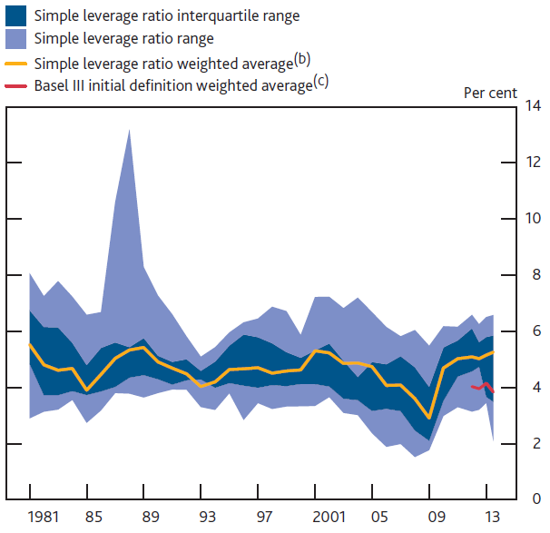
Leverage of UK Major Banks ^{(a)}
Source: Bank of England FPC Policy Statement, January 2014
The mean and ranges shown are based on the simple leverage ratio defined as the ratio of shareholders’ claims to total assets based on banks’ published accounts (note a discontinuity due to introduction of IFRS accounting standards in 2005, which tends to reduce leverage ratios thereafter). Data exclude Northern Rock/Virgin Money from 2008.
Weighted by total assets.
This corresponds to the estimates submitted to the PRA by banks on a best endeavours basis based on the original Basel III 2010 definition (BCBS (2010d)) (aggregate peer group Tier 1 capital over aggregate leverage ratio exposure).
Notes:
21

Slide 22
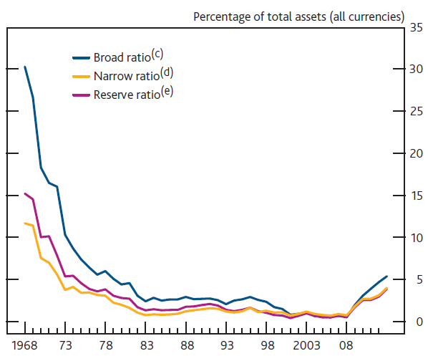
UK Banks liquidity ratio^{(a) (b)}
Source: Financial Stability Report, June 2012
(a) Data for building societies are included from 2010 onwards. Prior to this, data are for
UK banks only. (b) Data are end-year except for 2012 where end-April data are used. (c) Cash + Bank of England balances + money at call + eligible bills + UK gilts. (d) Cash + Bank of England balances + eligible bills. (e) Proxied by: Bank of England balances + money at call + eligible bills.
Notes:
22

