Slide 1
A Friendly Introduction to Microfinance
with Sanghmitra Gautam

Slide 2
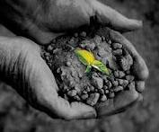
The start of Microfinance
Why was there a gap in service?
The first Microfinance loan:
USD 27.00 lent to a group of 42 women in rural Bangladesh
Each of the women made a profit of USD 0.02

Slide 3
Before Microfinance
Self-Help Groups (SHG)
ROSCAs (Rotating Savings and Credit Association)
Post Offices in India
‘SUSU’ Collectors in Ghana
Community Banks (NABARD India)

Slide 4
What did Microfinance bring?
Instutionalized the process of lending credit
Grameen Bank in Bangladesh (1983)
Transition from Microcredit to Microfinance
Financial self-sufficiency
Sustainable productivity from credit
Access to financial services

Slide 5
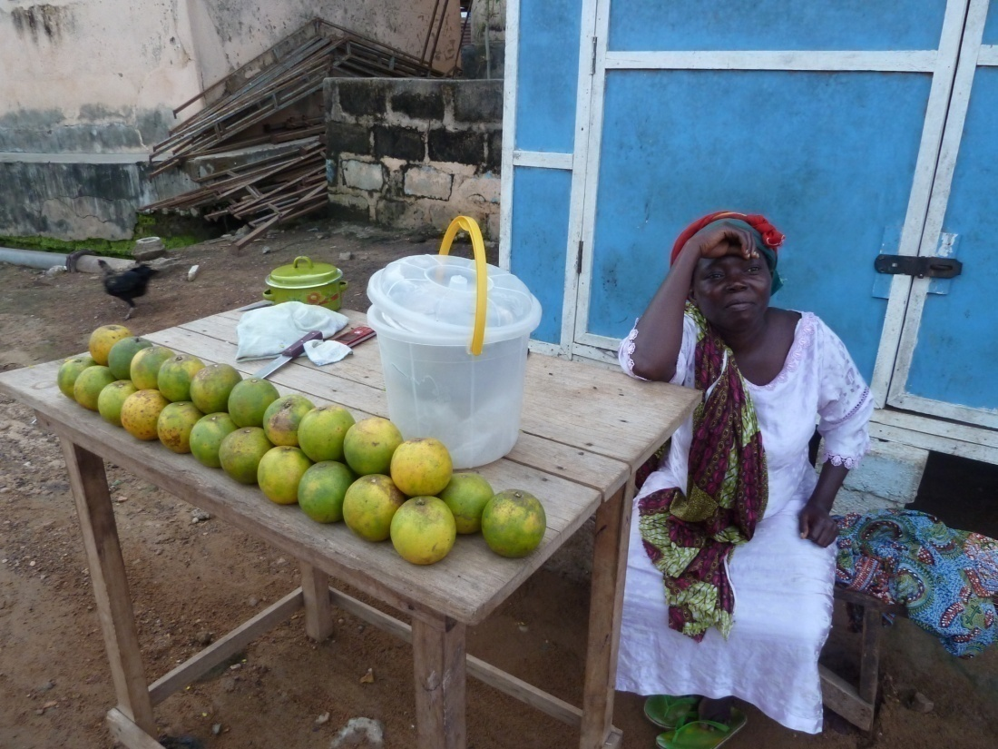
Household Demand
Savings:
Education of children
Insurance against shocks (Health, Weather etc.)
Smoothing Household consumption
Loans:
Investment to increase productivity

Slide 6
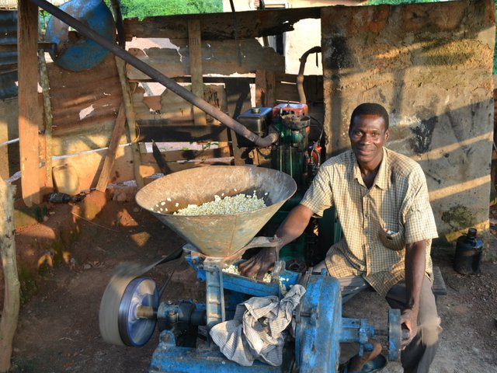
Supply
‘provide loans for investment in an income generating activity’

Slide 7
Theory behind the policy
Why doesn’t the free market supply financial services?
The standard Principal – Agent Problem
Presence of Asymmetric Information
Transaction Costs
Adverse Selection (Screening/Signalling)
Moral Hazard (Monitoring)
Enforcement Costs (Repayment of loans)

Slide 8
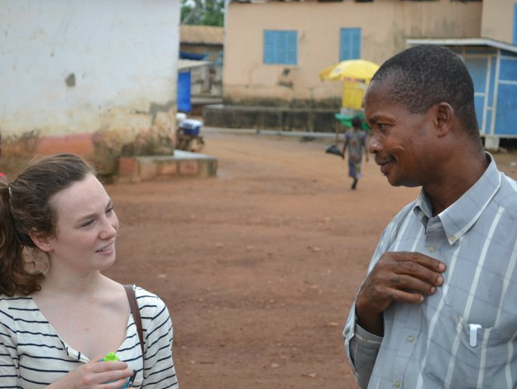
How does it work?
GROUP LENDING
Mechanism: Joint Liability Default Clause
Delegation of agency costs to the borrowers
Efficiency gains – borrowers can screen, monitor and enforce repayments at a lower cost
Enforcement of repayment via social sanction among peer members

Slide 9
How does it work?
INDIVIDUAL LENDING
Mechanisms
Progressive Lending
Loans conditional on savings
Loans to Women
Public disclosure of borrowers’ repayment history
Non-Refinancing threat
Cross Reporting (MFIs)

Slide 10
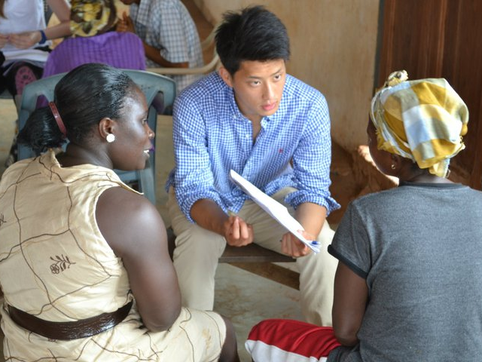
Many Faces of Microfinance
Loans for income generating activities
Small scale investment in machinery
Livestock (e.g. dairy farming)
Cash loans to smooth Household consumption
Seasonal liquidity constraints
Micro Insurance
Micro Savings

Slide 11
Many Faces of Microfinance
Recent Developments
M-Pesa in Kenya
Loans to urban poor (Developed Countries)
Loans for health infrastructure – Clean water and sanitation

Slide 12
THANK YOU

